Slide 1
Entrepreneurship: An Introduction
January 2018

Slide 2
Who are entrepreneurs?
Identify opportunities, mobilize resources, and relentlessly execute on their vision
Identify and pursue solutions among problems, possibilities among needs, and opportunities among challenges
Tech entrepreneurs use information technology (IT) to solve problems and exploit opportunities
Combine capabilities and skills with interests, passion and commitment
Spot opportunities and execute ~ a favorable juncture of circumstances with a good chance for success or progress

Slide 3
Many ways to entrepreneur
Entrepreneurship versus intrapreneurship
Social entrepreneurship / government entrepreneurship
Entrepreneurship versus a trading business

Slide 4
The opportunity sweet spot
Attractive opportunity
• Timely
• Solvable
• Important
• Profitable
• Favorable context
Capabilities
and skills
• Good at the
needed tasks
• Willingness
to learn
Interest, passions,
and commitment
• Like to do the tasks
• Like the challenge
• Committed to do what
is necessary
The
sweet
spot

Slide 5
1. Who are some of the tech entrepreneurs you are familiar with?

Slide 6
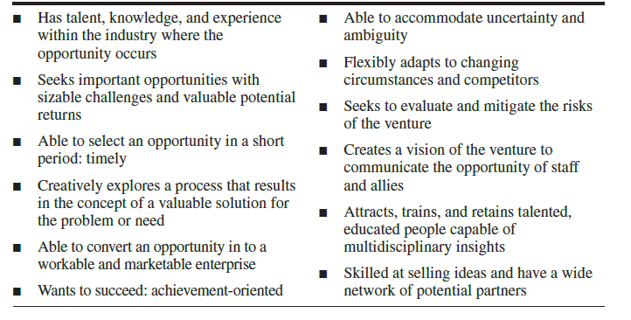
Characteristics of great entrepreneurs

Slide 7
2. Are entrepreneurs born or made?

Slide 8
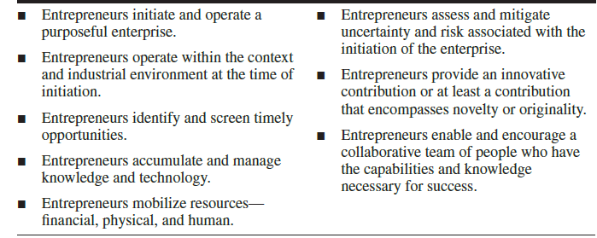
Skills/ activities of entrepreneurs

Slide 9
Economics and the firm
Economics ~ the study of the production, distribution and consumption of goods and services.
Economy
Entrepreneurs as agents of progress
Natural Capital
Beneficial outputs
Financial Capital
Intellectual Capital
Undesired waste outputs
Human Capital: Organizational capital: Social Capital

Slide 10
Firm’s Intellectual Capital
Human Capital
Organizational Capital
Social Capital
Society
Workers and associates
Firm’s mission and purpose
Market
Customers
Technology
Competitors
Suppliers

Slide 11
Innovation and disruption
Salman Khan on Khan Academy

Slide 12
10 people to read about
Mark Zuckerberg (Facebook)
Jeff Bezos (Amazon)
Jack Ma (Alibaba)
Sergey, Brin (Google)
Lerner, Sara (Cisco)
Mohamed Yunus (Grameen)
Shwed Gil (Checkpoint)
Mo Ibrahim (Celtel Africa)
Li Robin (Baidu)
Diane Greene (VMWare USA)

Slide 13
Recap

